Slide 1
Graduation Project Presentation
Team Members:
Aya Hesham Hussien
Youssef Mohamed Abulmagd
Track: Software Testing
Supervisor: Eng/Mohamed Elshafey
Date: 22-10-2024

Slide 2
Introduction:
Software testing is a crucial activity in the software development life cycle that aims to evaluate and improve the quality of software products. Thorough testing is essential to ensure software systems function correctly, are secure, meet stakeholders’ needs, and ultimately provide value to end users.
This project involved two tasks:
Manual Testing: Analyzing user stories and writing test cases.
Automation Testing: of an e-commerce website.
Tools Used:
Jira, Qase (Test management tools)
Selenium WebDriver , Java , POM Design Pattern
TestNG, Cucumber. (Frameworks)

Slide 3
Difference between manual and automation testing:
Aspect | Manual Testing | Automation Testing
Definition | Testing software manually without automation tools. | Using automated tools to run tests on the software.
Speed | Slower, as tests are executed by humans. | Faster execution, especially for repetitive tests.
Cost | Can be less expensive initially; requires more human resources. | Higher initial cost for tools and setup but can save money in the long run.
Accuracy | Prone to human error and inconsistency. | More accurate, as tests are executed the same way every time.
Test Coverage | Limited by time and effort; harder to cover large test cases. | Can execute a large number of tests quickly, improving coverage.
Flexibility | Easily adaptable for exploratory testing. | Less flexible; requires maintenance of scripts for changes.
Best For | Usability, exploratory, and ad-hoc testing. | Regression, performance, and load testing.
Maintenance | Minimal; simply needs testers’ time and attention. | Requires ongoing updates to scripts as software changes.

Slide 4
Manual Testing:
User Story 1:
As a customer, I want to filter products by category, so I can easily find items that match my interest.
From this user story, we derived test cases to check product filtering functionality, filtering functionality in mobile and desktop, and correct product details display.“
User Story 2:
As a citizen, I want to apply for a new passport online, so I can avoid visiting the passport office in person.
From this user story , we access the online portal and complete the application process for a new passport through filling out personal information, uploading necessary documents, and making the required payment
User Story 3:
As a patient, I want to schedule an appointment with my doctor online so that I can choose a convenient time without calling the office.
From this user story , We log into the healthcare portal and schedule an appointment by selecting the preferred date and time from the available options, schedule an appointment, and receive confirmation without the need for phone calls. The patient should also have the ability to reschedule or cancel the appointment if necessary.

Slide 5





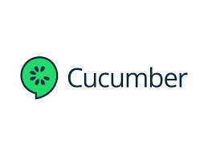

Tools Used in automation:

Slide 6
Automation Testing:
Scenario 1: Register
TC1: Validate an error message is displayed when user leave “Confirm Password” field empty.
TC2: Validate an error message is displayed when user enter password and confirm password does not match each other.
TC3: Validate that user after register with valid data, will be navigated to My Account page.
Scenario 2: Login
TC1: Validate That user can login with registered email and password.
Scenario 3: Landing Page
TC1: Validate That Hot Sellers is displayed and each card contains Price in $
TC2: Validate That each card contains “Add to Cart” button and clickable
TC3: Validate That Guest user can add product to cart

Slide 7
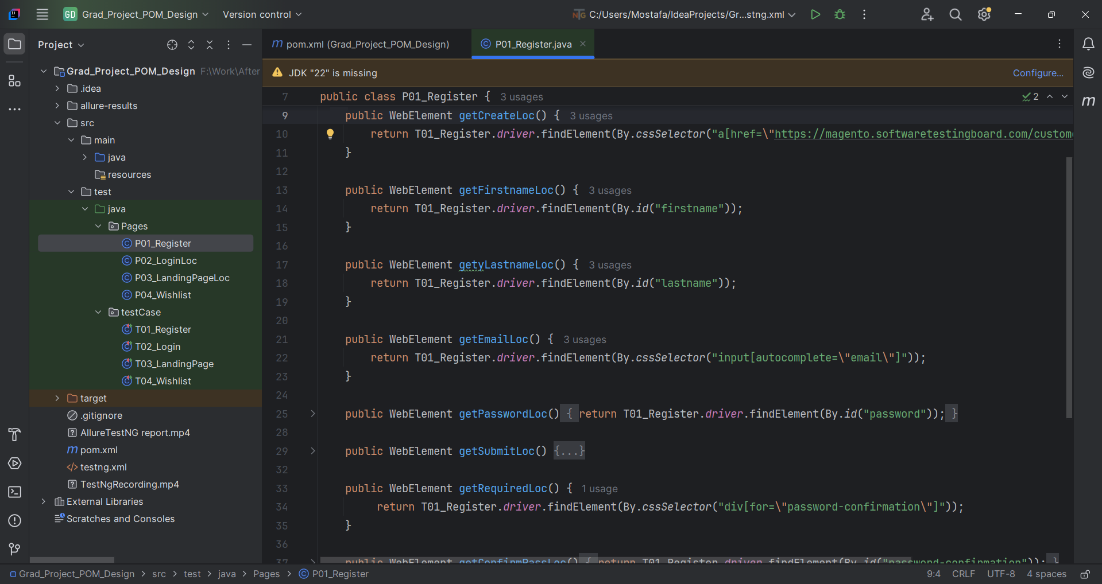
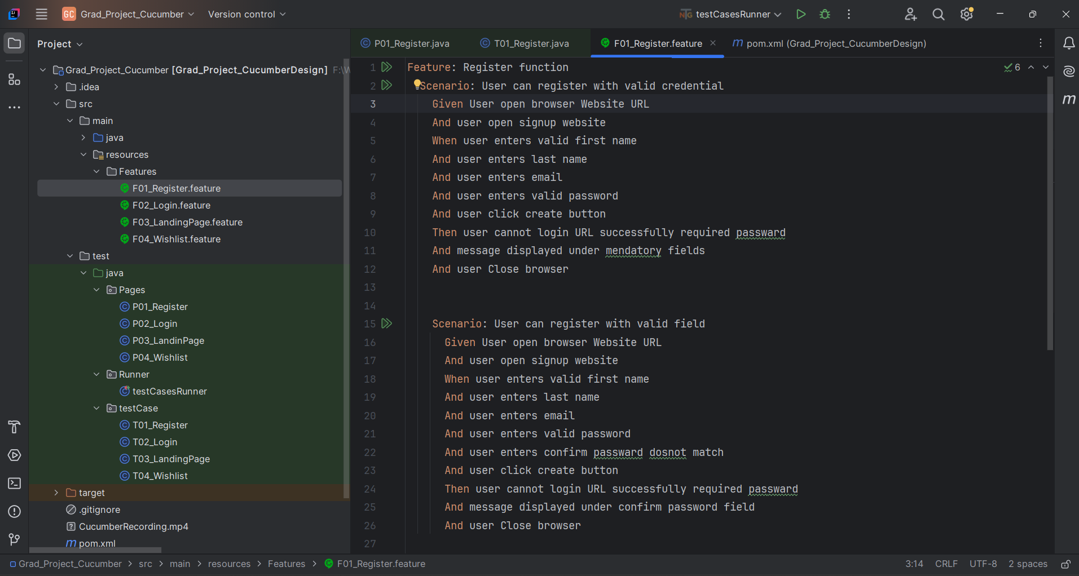
Scenario 4: Wishlist
TC1: Validate that Guest user can’t add any product to Wishlist
TC2: Validate That Logged in user can add any product to Wishlist

Slide 8
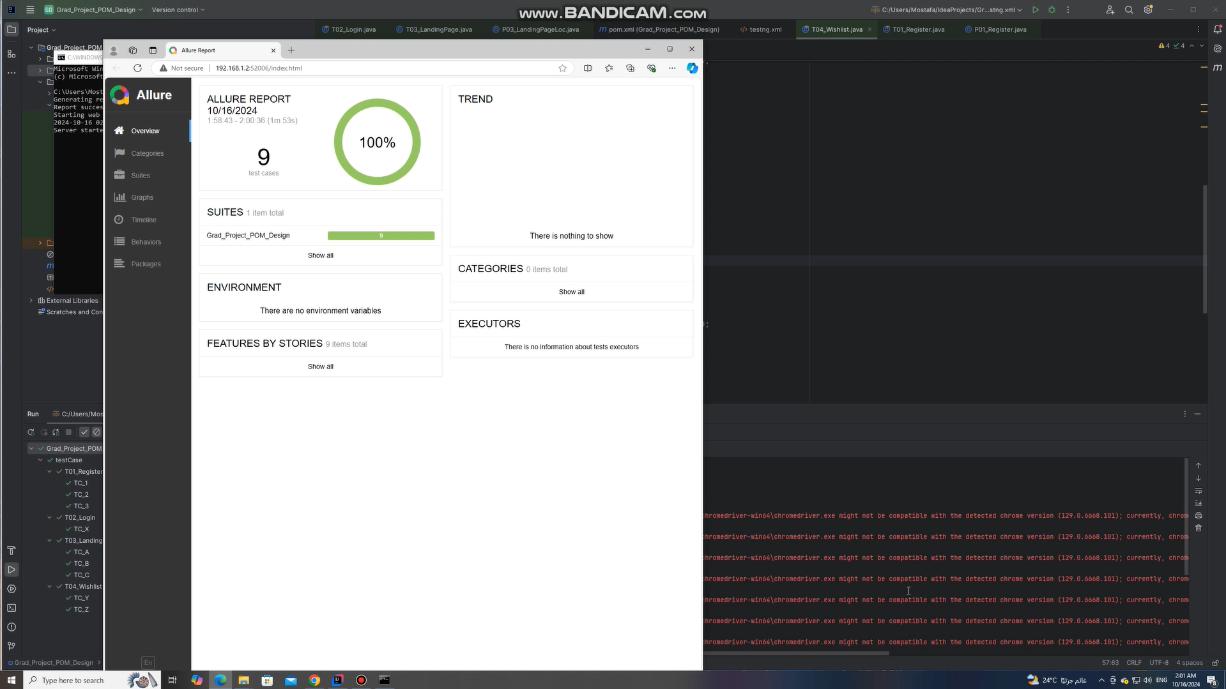
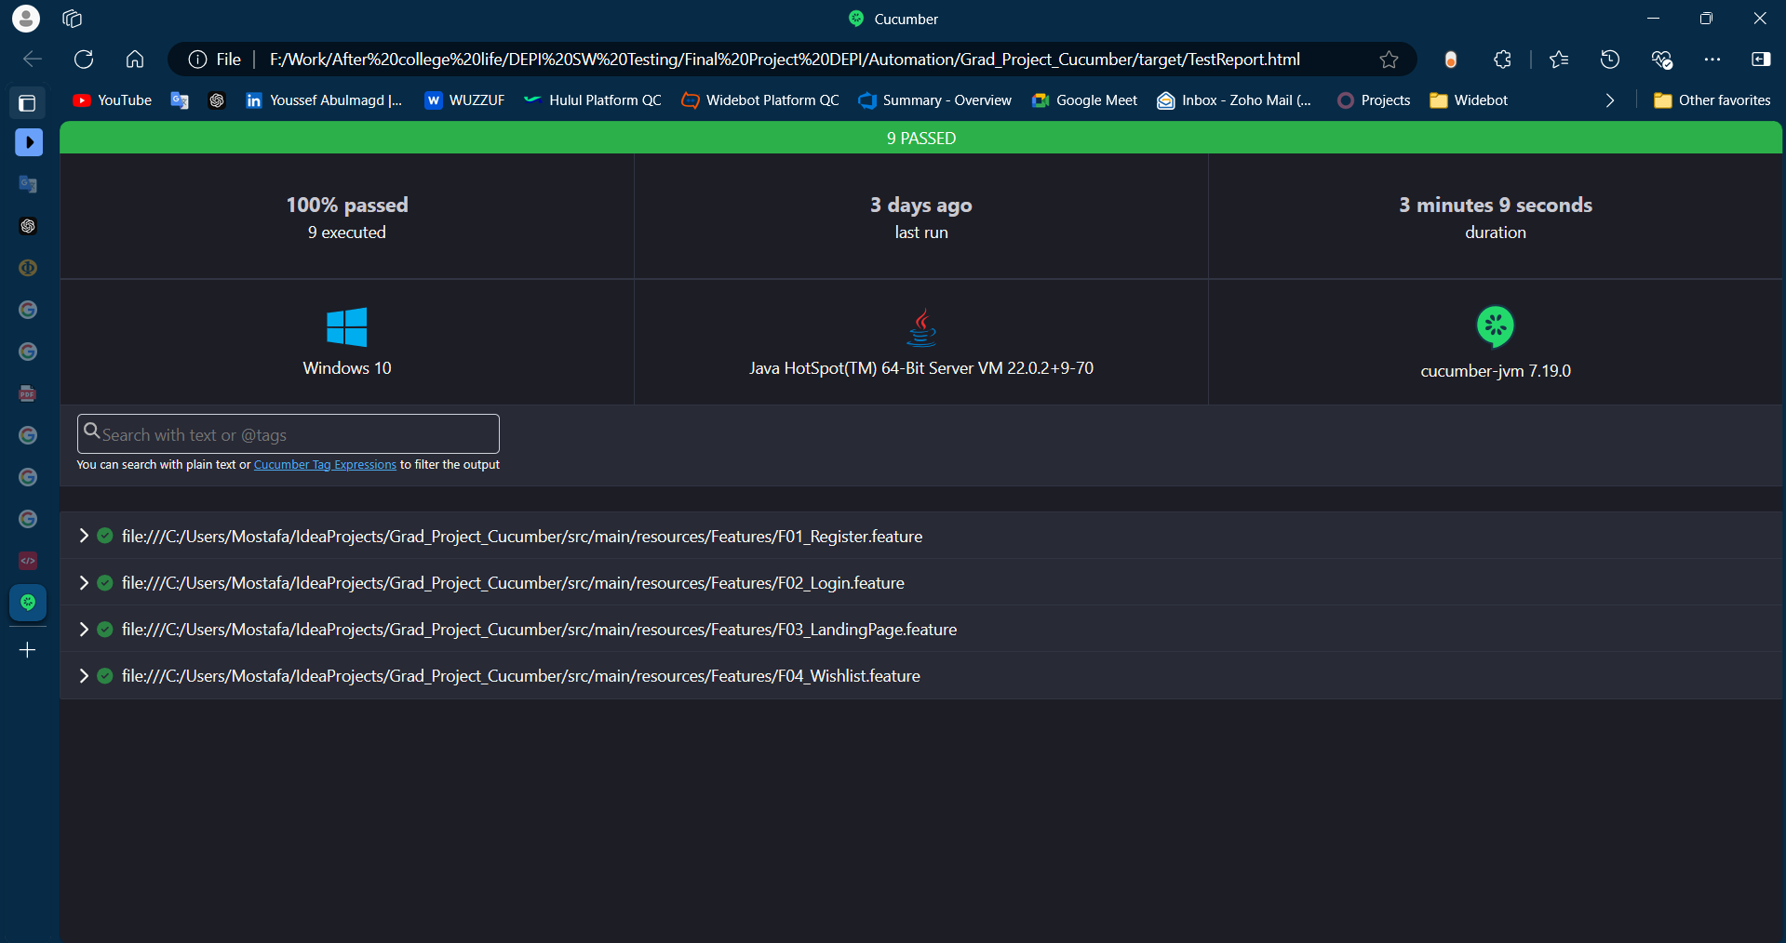
Reporting with TestNG(Allure Report):
Reporting with Cucumber (Cucumber Report):

Slide 9
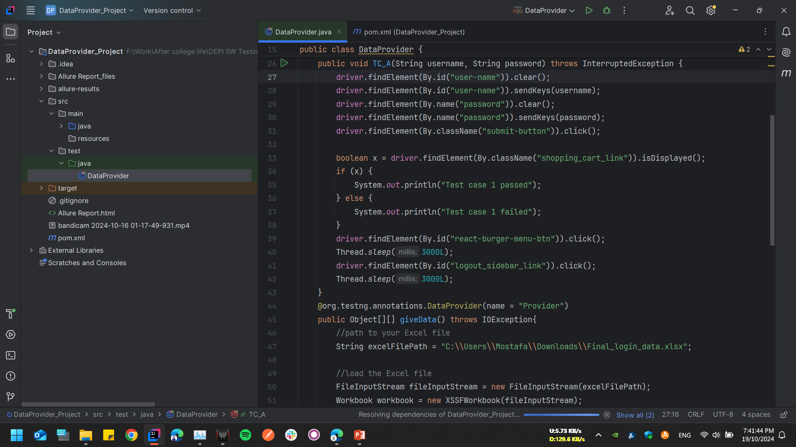
DataProvider:
We faced some problems when trying to login with different usernames and password so instead of writing every username and password, we used data provider feature to test login with different usernames and passwords, DataProvider is like a container that passes the data to our test methods so that our single test method can execute itself with multiple data sets.

Slide 10
Thank You!! 😊

